Slide 1
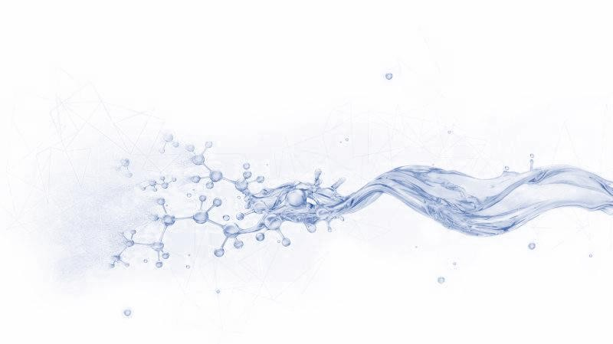
Technical Data Sheet
VISCOSIFIER FOR DRILL-IN FLUID
Date issued：2024-6-10
PF-EZVIS
PF-EZVIS is a viscosifier suitable for reservoir drilling fluids. It is easily soluble in water, and has good dispersibility. It is a chain polysaccharide polymer with small molecular weight and high viscosity. It is a high-efficiency thickener suitable for fresh water, salt water and saturated salt water drilling fluids.
FEATURES
Strong salt resistance
Increase viscosity at low shear rate
Strong shear thinning
Acid and alkali resistance
Minimal reservoir damage
Specification
Appearance | Light yellow free- flowing powder
Moisture,% | ≤10
Fineness (standard sieve 60 mesh),% | ≥90
Starch or its derivatives | None
APPLICATION
Suitable for fresh water, salt water drill-in fluids
Applicable temperature: ≤340℉ (170℃)
Recommended dosage: 0.6-2.8ppb ( 2-8 kg/m³)
PACKAGE & STORAGE
Specifications of packaging: Composite packaging bag or as per client’s requirements
Packing size: 25kg per sack (55 lb per sack) or as per client’s requirements
Storage Conditions: Store in dry area. Avoid open flame, high-temperature environment
www.cosl.com.cn
China Oilfield Services Limited
No.81, Xinggong West Street, Yanjiao,
Sanhe, Hebei, China
zhangxd11@cosl.com.cn
+86-10-8452 2344
This information is supplied solely for informational purposes and COSL makes no guarantees or warranties, either expressed or implied, with respect to the accuracy and use of this data. All product warranties and guarantees shall be governed by the Standard Terms of Sale.
Nothing in this document is legal advice or is a substitute for competent legal advice.

