Slide 1
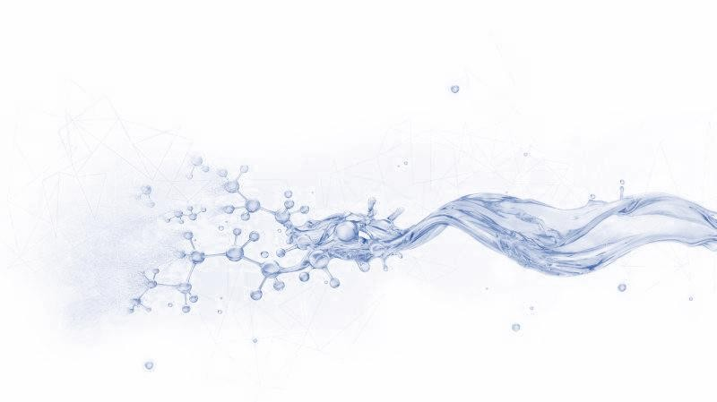
Technical Data Sheet
FILTRATE REDUCER FOR DRILL-IN FLUID
Date issued：2024-6-10
PF-EZFLO
PF-EZFLO is a white free-flowing powder. It is a modified starch- based fluid loss agent. It has good fluid loss reduction and flow pattern adjustment characteristics, as well as good natural degradation characteristics.
FEATURES
Strong salt resistance
Good filter loss reduction effect
Good natural degradation performance
Minimal reservoir damage
Specification
Appearance | White free-flowing powder
Moisture,% | ≤12
pH | 8.0-10.0
APPLICATION
Suitable for fresh water, salt water drill-in fluids
Applicable temperature: ≤280℉ (140℃)
Recommended dosage:3.5-10.5ppb (10-30kg/m³)
PACKAGE & STORAGE
Specifications of packaging: Composite packaging bag or as per client’s requirements
Packing size: 25kg per sack (55 lb per sack) or as per client’s requirements
Storage Conditions: Store in dry area. Avoid open flame, strong oxidant, high-temperature environment
www.cosl.com.cn
This information is supplied solely for informational purposes and COSL makes no guarantees or warranties, either expressed or implied, with respect to the accuracy and use of this data. All product warranties and guarantees shall be governed by the Standard Terms of Sale.
Nothing in this document is legal advice or is a substitute for competent legal advice.
China Oilfield Services Limited
No.81, Xinggong West Street, Yanjiao,
Sanhe, Hebei, China
zhangxd11@cosl.com.cn
+86-10-8452 2344

