Slide 1
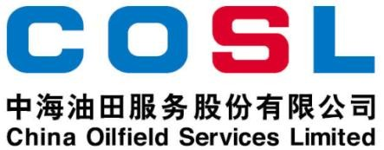
Technical Data Sheet
SHALE INHIBITOR
Date issued： 2024-6-10
PF-UHIB
PF-UHIB is an amine derivative utilized to inhibit clay hydration and swelling. PF-UHIB can inhibit clay hydration and swelling ， by preventing water and clay together , to keep cuttings integrity. It effectively inhibits shale and clay from hydrating and reduces the probability of bit balling.
Specification
Appearance | Yellow liquid
Density， g/cm³ | 1.08±0.02
pH（1% solution） | ＞9
FEATURES
Inhibit clay, shale and cuttings dispersion
Stabilize pH value
Strong anti-pollution ability
APPLICATION
Suitable for fresh water, salt water-based drilling fluids
Recommended dosage: 3.5-10.5ppb (10-30kg/m³)
PACKAGE & STORAGE
Specifications of packaging: Plastic bucket or as per client’s requirements
Packing size: 200L/bucket or as per client’s requirements
Storage conditions: Store in dry area. Avoid open flame, strong oxidant, high-temperature environment
www.cosl.com.cn
This information is supplied solely for informational purposes and COSL makes no guarantees or warranties, either expressed or implied, with respect to the accuracy and use of this data. All product warranties and guarantees shall be governed by the Standard Terms of Sale.
Nothing in this document is legal advice or is a substitute for competent legal advice.
China Oilfield Services Limited
No.81, Xinggong West Street, Yanjiao,
Sanhe, Hebei, China
zhangxd11@cosl.com.cn
+86-10-8452 2344

