Slide 1
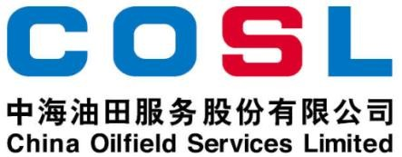
Technical Data Sheet
ANTI-BIT BALLING LUBRICANT
Date issued： 2024-6-10
PF-HLUB
PF-HLUB is a special blend of surfactants to prevent bit free of solids and enhances the rate of penetration (ROP) in water- based drilling fluids, especially when run with polycrystalline diamond compact (PDC) bits. The chemical makeup of the PF- HLUB additive assists in removing any buildup of drill solids below the bit, allowing the cutters to make continuous contact with new formation, and also lowers torque and drag.
Specification
Appearance | Yellow brown liquid
Density, g/cm³ | 0.84±0.01
Freezing point, ℃ | -30
Flash point,℃ | ≥100（Open cup）
FEATURES
Contain wetting agent to reduce the potential for bit and BHA balling
Increase ROP while drilling mudstone and shales
Improve bit life, reducing the number of trips
Reduce torque and drag
Not induce foaming or aeration of the mud system
APPLICATION
Applied in young mudstone formation
Especially effective for deep water drilling fluids
Applicable temperature:≤350℉ (180℃)
Recommended dosage: 3.5-7.0ppb (10-20kg/m³)
Limitation: Flocculation may be noted at high pH value
PACKAGE & STORAGE
Specifications of packaging: Plastic bucket or as per client’s requirements
Packing size: 200L/bucket or as per client’s requirements
Storage conditions: Store in dry area. Avoid open flame, strong oxidant, high- temperature environment
www.cosl.com.cn
This information is supplied solely for informational purposes and COSL makes no guarantees or warranties, either expressed or implied, with respect to the accuracy and use of this data. All product warranties and guarantees shall be governed by the Standard Terms of Sale.
Nothing in this document is legal advice or is a substitute for competent legal advice.
China Oilfield Services Limited
No.81, Xinggong West Street, Yanjiao,
Sanhe, Hebei, China
zhangxd11@cosl.com.cn
+86-10-8452 2344

