Slide 1
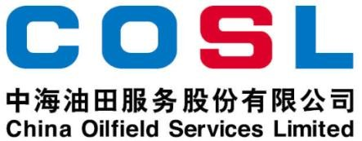
Technical Data Sheet
Strong network plugging agent
Date issued: 2024-6-10
PF-NETLOCK
PF-NETLOCK is an auxiliary series of products to improve plugging efficiency for serious lost circulation, with compressible and high resiliency network plugging structure. The product will form a perfect "filter net" after entering the fracture. The captured bridging particles are then gathered together to form a whole plugging layer quickly, thus filling the fracture effectively.
FEATURES
High pressure compressibility
High resilience
Increase formation pressure-bearing capacity
Specification
Appearance | Black or gray coarse grained reticulated foam
True density，g/cm³ | ≤8
Bulk density，g/cm³ | ≤2
APPLICATION
Suitable for serious leakage formation
Applicable temperature: ≤ 284 ℉
Recommended dosage: 0.35-1.05ppb
Application limitation: not used for reservoir drilling fluid
PACKAGE & STORAGE
Specifications of packaging: Composite packaging bag or as per client’s requirements
Packing size: 25kg per sack or as per client’s requirements
Storage conditions: Store in dry area. Avoid open flame, strong oxidant, high-temperature environment
www.cosl.com.cn
This information is supplied solely for informational purposes and COSL makes no guarantees or warranties, either expressed or implied, with respect to the accuracy and use of this data. All product warranties and guarantees shall be governed by the Standard Terms of Sale.
Nothing in this document is legal advice or is a substitute for competent legal advice.
China Oilfield Services Limited
No.81, Xinggong West Street, Yanjiao,
Sanhe, Hebei, China
zhangxd11@cosl.com.cn
+86-10-8452 2344

