Slide 1
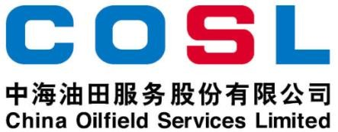
Technical Data Sheet
PRESSURE BEARING AGENT WHILE DRILLING
Date issued： 2024-6-10
PF-STRH
PF- STRH is designed as fracture sealing and wellbore strengthening materials for fractured formations while drilling with water-based drilling fluids. It can effectively reduce the potential for differential sticking and lost circulation through sealing problem zones.
FEATURES
Effective sealing leakage formation
Improve the bearing capacity of formation
Good compatibility with drilling fluids
Specification
Appearance | Gray free flowing powder
Moisture, % | ≤5
Fineness (80 mesh standard sieve)，% | ≥85
APPLICATION
Applied in leakage formations
Applicable temperature: ≤390℉ (200℃)
Recommended dosage: 7-10.5ppb (20-30kg/m³)
PACKAGE & STORAGE
Specifications of packaging: Composite packaging bag or as per client’s requirements
Packing size: 25kg per sack (55 lb per sack) or as per client’s requirements
Storage conditions: Store in dry area
www.cosl.com.cn
This information is supplied solely for informational purposes and COSL makes no guarantees or warranties, either expressed or implied, with respect to the accuracy and use of this data. All product warranties and guarantees shall be governed by the Standard Terms of Sale.
Nothing in this document is legal advice or is a substitute for competent legal advice.
China Oilfield Services Limited
No.81, Xinggong West Street, Yanjiao,
Sanhe, Hebei, China
zhangxd11@cosl.com.cn
+86-10-8452 2344

