Slide 1
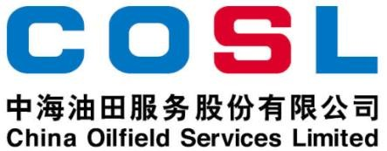
Technical Data Sheet
PRIMARY EMULSIFIER FOR FLAT- RHEOLOGY SYNTHETIC BASED DRILLING
^{FLUIDS} Date issued： 2024-6-10
PF-FSEMUL
PF-FSEMUL is a fatty acid modified surfactant，used as the primary emulsifier in the flat-rheology synthetic based drilling fluids. It is used in conjunction with PF-FSCOAT and PF-FSWET to reduce the interfacial tension between oil and water and form a stable water-in-oil emulsion.
Specification
Appearance | Amber viscous liquid
Density, g/cm³ | 0.96±0.02
Pour Point,℃ | ≤-8
FEATURES
Effectively improve emulsification stability
Help to reduce HTHP fluid loss
Help to improve LSRV
Help to improve thermal stability of SBM
APPLICATION
Suitable for flat-rheology synthetic based drilling fluids
Suggestion temperature:≤ 430℉ (220℃)
Recommended dosage:2.5-5.5 ppb (7-16 kg/m³)
PACKAGE & STORAGE
Specifications of packaging: Plastic bucket or as per client’s requirements
Packing size: 200L/bucket or as per client’s requirements
Storage conditions: Store in dry area. Avoid open flame, high-temperature environment
www.cosl.com.cn
This information is supplied solely for informational purposes and COSL makes no guarantees or warranties, either expressed or implied, with respect to the accuracy and use of this data. All product warranties and guarantees shall be governed by the Standard Terms of Sale.
Nothing in this document is legal advice or is a substitute for competent legal advice.
China Oilfield Services Limited
No.81, Xinggong West Street, Yanjiao,
Sanhe, Hebei, China
zhangxd11@cosl.com.cn
+86-10-8452 2344

