Slide 1
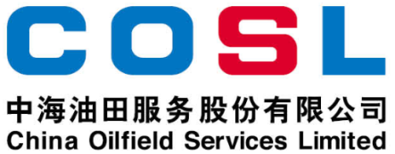
PE-PCC
FLOCCULANT
Product Description
PE-PCC is a mixture of high-charged inorganic polymer ring chains and inorganic salts, which is easily soluble in water and low corrosion.
Main Features
Fast floc formation and fast settling;
Less corrosive;
Less salt increase in treated water;
Strong adaptability to temperature;
Applied Range
Suitable for drilling fluid systems and water-based drilling fluid/cuttings;
Recommended dosage: 60～100 kg/m³.
Packaging and Storage
Packaging Requirements: Plastic bucket or according to user requirements;
Packing specification: 25 L/barrel or according to user requirements;
Storage conditions: Store in a dry and ventilated place, away from heat and fire sources;
Shelf life: 24 months.
Physical and Chemical Properties
Item | Parameters
Appearance | Colorless or yellowish homogeneous liquid
Density, g/cm³ | 1.15～1.25
Insolubles，% | ≤1.5
pH (1%） | 3～6
Flocculation duration, s | ≤30
This information is supplied solely for informational purposes and COSL makes no guarantees or warranties, either expressed or implied, with respect to the accuracy and use of this data. All product warranties and guarantees shall be governed by the Standard Terms of Sale. Nothing in this document is legal advice or is a substitute for competent legal advice.
www.cosl.com.cn
China Oilfield Services Limited
No.81, Xinggong West Street, Yanjiao, Sanhe, Hebei, China

