Slide 1
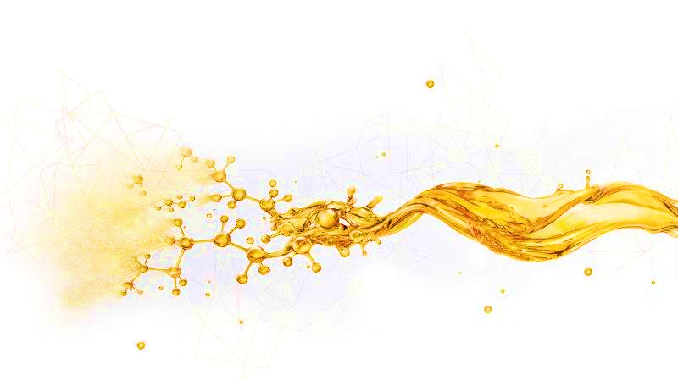
PE-LW21L
Fluid Stabilizer
Descriptions
PE-LW21L can be used to prolong the solidification time of various flowback cement slurries, so that the flowback cement slurry can be stabilized in a flowing state for a long time, which is convenient for the sea transportation of flowback cement slurry and ensures post-processing
Features
Effectively prolong the solidification time of cement slurry
Ensure stable flow state of flowback cement slurry
Applicable to cement slurry systems with different densities
Applications
Recommended dosage:10 kg～40 kg/m³
After mixing with the backflow cement slurry evenly, it can be stored at rest
Packaging, storage and transportation
Packaging requirements: plastic bucket or according to user requirements
Packing specification: 25 L/barrel or according to user requirements
Storage conditions: Store in a dry and ventilated place, away from heat and fire sources
Shelf life: 24 months
Physical and chemical properties
Item | Parameters
Exterior | Colorless to pale yellow liquid
Density（25±2℃），g/cm³ | 1.22～1.28
Retardation time（24℃，normal pressure），d | ≥15（Not reaching final setting）
Retardation time（40℃，normal pressure），d | ≥15（Not reaching final setting）
This information is supplied solely for informational purposes and COSL makes no guarantees or warranties, either expressed or implied, with respect to the accuracy and use of this data. All product warranties and guarantees shall be governed by the Standard Terms of Sale. Nothing in this document is legal advice or is a substitute for competent legal advice.
www.cosl.com.cn
China Oilfield Services Limited
No.81, Xinggong West Street, Yanjiao, Sanhe, Hebei, China
Notes:
1

